Slide 1
Inventory Management

Slide 2
Inventory
Inventory: a stock or store of goods
Independent Demand
A
Dependent Demand
B(4)
C(2)
D(2)
E(1)
D(3)
F(2)
Independent demand is uncertain. Dependent demand is certain.

Slide 3
Types of Inventories
Raw materials & purchased parts
Partially completed goods called work in progress
Finished-goods inventories
(manufacturing firms) or merchandise (retail stores)

Slide 4
Types of Inventories (Cont’d)
Replacement parts, tools, & supplies
Goods-in-transit to warehouses or customers

Slide 5
Functions of Inventory
To meet anticipated demand
To smooth production requirements
To decouple operations
To protect against stock-outs

Slide 6
Functions of Inventory (Cont’d)
To take advantage of order cycles
To help hedge against price increases
To permit operations
To take advantage of quantity discounts

Slide 7
Objective of Inventory Control
To achieve satisfactory levels of customer service while keeping inventory costs within reasonable bounds
Level of customer service
Costs of ordering and carrying inventory
Inventory turnover is the ratio of average cost of goods sold to average inventory investment.

Slide 8
Effective Inventory Management
A system to keep track of inventory
A reliable forecast of demand
Knowledge of lead times
Reasonable estimates of
Holding costs
Ordering costs
Shortage costs
A classification system

Slide 9
Inventory Counting Systems
Periodic System
Physical count of items made at periodic intervals
Perpetual Inventory System System that keeps track of removals from inventory continuously, thus monitoring current levels of each item

Slide 10
Inventory Counting Systems (Cont’d)
Two-Bin System - Two containers of inventory; reorder when the first is empty
Universal Bar Code - Bar code printed on a label that has information about the item to which it is attached
0
214800 232087768

Slide 11
Key Inventory Terms
Lead time: time interval between ordering and receiving the order
Holding (carrying) costs: cost to carry an item in inventory for a length of time, usually a year
Ordering costs: costs of ordering and receiving inventory
Shortage costs: costs when demand exceeds supply

Slide 12
Economic Order Quantity Models
Economic order quantity (EOQ) model
The order size that minimizes total annual cost
Economic production model
Quantity discount model

Slide 13
Assumptions of EOQ Model
Only one product is involved
Annual demand requirements known
Demand is even throughout the year
Lead time does not vary
Each order is received in a single delivery
There are no quantity discounts

Slide 14
The Inventory Cycle
Figure 12.2
Profile of Inventory Level Over Time
Q
Usage
rate
Quantity
on hand
Reorder
point
Time
Receive
order
Place
order
Receive
order
Place
order
Receive
order
Lead time

Slide 15
Total Cost
Annual
carrying
cost
Annual
ordering
cost
Total cost =
+
Q
D
TC =
H
+
S
2
Q

Slide 16
Cost Minimization Goal
Figure 12.4C
The Total-Cost Curve is U-Shaped
Annual Cost
Ordering Costs
Q_{O}
(optimal order quantity)
Order Quantity (Q)

Slide 17
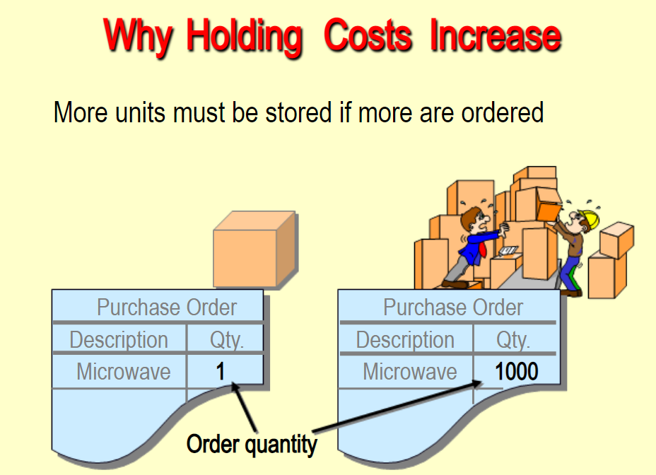

Slide 18
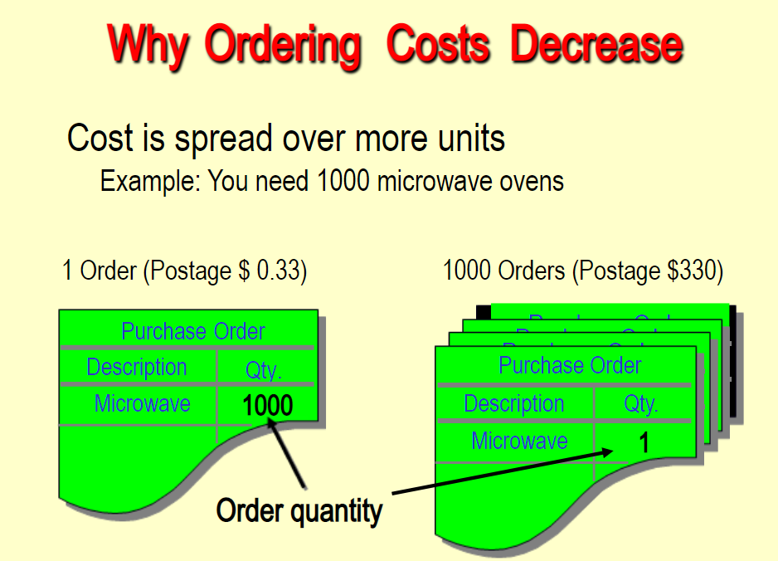

Slide 19
Deriving the EOQ
Using calculus, we take the derivative of the total cost function and set the derivative (slope) equal to zero and solve for Q.

Slide 20
Minimum Total Cost
The total cost curve reaches its minimum where the carrying and ordering costs are equal.
Length of an order cycle = Q/D
No of orders per year=D/Q
Q
D
H
=
S
2
Q

Slide 21
A local distributor for a national company expects to sell approx 9600 steel belted radial tires of a certain size and tread design next year. Annual holding cost is $16 per tire and ordering cost is $75. The distributor operates 288 days a year.
What is EOQ?
How many times per year does the store reorder?
What is the length of an order cycle?
What is total annual cost if EOQ is ordered?

Slide 22
Piddling manufacturing assembles security monitors. It purchases 3600 black and white cathode ray tubes a year at $65 each. Ordering costs are $31 and annual carrying costs are 20% of the purchase price. Compute EOQ and Total annual cost of ordering and carrying the inventory.

Slide 23
Economic Production Quantity (EPQ)
Production done in batches or lots
Capacity to produce a part exceeds the part’s usage or demand rate
Assumptions of EPQ are similar to EOQ except orders are received incrementally during production

Slide 24
Economic Production Quantity Assumptions
Only one item is involved
Annual demand is known
Usage rate is constant
Usage occurs continually
Production rate is constant
Lead time does not vary
No quantity discounts

Slide 25
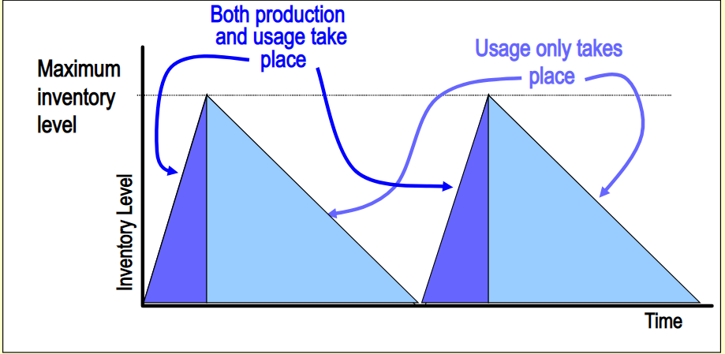
Economic Run Size

Slide 26
A toy manufacturer uses 48000 rubber wheels per year for its popular dump truck series. The firm makes its own wheels, which it can produce at a rate of 800 per day. The toy trucks are assembled uniformly over the entire year. Holding cost is $1 per wheel a year Setup cost is $45. The firm operates 240 days per year. Determine
Optimal run size
TC

Slide 27
Total Costs with Purchasing Cost
Annual
carrying
cost
Annual
ordering
cost
Purchasing
cost
TC =
+
+
Q
D
TC =
H
+
S
PD
+
2
Q

Slide 28
Total Costs with PD
Figure 12.7
Cost
Adding Purchasing cost doesn’t change EOQ
TC with PD
TC without PD
PD
0
EOQ
Quantity

Slide 29
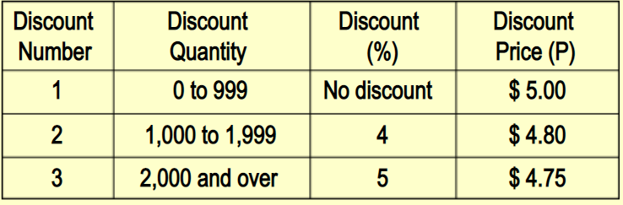
Quantity Discounts
Answers how much to order and when to order
Allows quantity discounts
Trade off is between lower price and increased holding cost

